Slide 1

ADVANCED BOOK RECOMMENDATION SYSTEM
Shayan Abdul Karim Khan
07/21/2023

Slide 2



OVERVIEW
INCREASE THE NUMBER OF BOOKS READ BY PEOPLE
MAKE IT SIMPLE AND EASY TO FIND NEW GOOD BOOKS
MAKE IT SIMPLE AND EASY TO EXPLORE NEW GENRES

Slide 3


SOLUTION
RECOMMENDATION SYSTEM
NO BOOK STORE RUNS
NO RESEARCHING BOOKS
QUARTERLY 5 BOOKS AVAILABLE
GOAL
RECOMMENDATION MODEL
5 BOOK RECOMMENDATIONS
SCENARIO 1
SCENARIO 2
SCENARIO 3
CURRENT USER
USER INFO
USER-ITEM INFO
NEW USER
USER INFO
USER-ITEM INFO
NEW USER
USER INFO
USER-ITEM INFO

Slide 4


ANALYSIS PROCESS
BOOK-CROSSING & GOOGLE BOOK API DATA
ITERATIVE DATA CLEANING & PROCESSING
Notes:
HOW WILL WE ACCOMPLISH THIS?
DATABASE
CLEANING/PROESSING
MODELLING
TOP 10 FEATURES AND A MODEL

Slide 5






EXPLORATORY ANALYSIS
TARGETTED NO OF REVIEWS > 19
AVG RATING 3.8/5
TARGETTED AGES 16 – 60
USA DOMINATED THE DATA
60% RATINGS UNKNOWN
70% OF COMPLETE DATA USED FOR TRAINING

Slide 6


MODELING RESULTS
Accuracy main evaluation criteria for models
SVD Best Performing Model
Accuracy range: 0.7
Example: Predicted Rating: 4.0 → Actual Rating: 3.3 – 4.7
Notes:
Remove the table
Plain text for RMSE explanation
No RMSE
Example for raatings

Slide 7







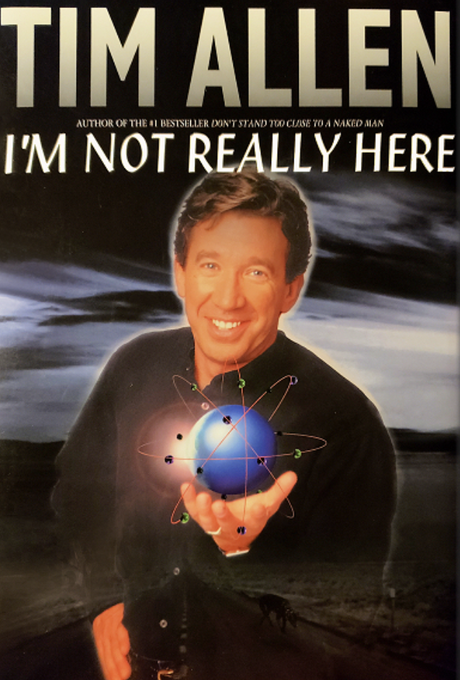


RECOMMENDATION SYSTEM RESULTS
Original liking for Humor, Mystery, Fiction, Storytelling
Humor, Mystery, Entertainment, Fiction genres recommended
Themes and genres area very similar to original likings
Popular titles recommended in similar genres
Eases into exploration of other genres and themes
4/5 recs spot on with original likings
Popular titles not already reviewed might be because of either missing data or book-based movies
Identified widely recognized books that have the potential to engage and captivate readers

Slide 8
CONCLUSION
Need more data on users and user-item interactions
MVP for initial customer acquisition and data gathering
User feedback and recommendations to improve for production
Notes:
Baseline Model for gathering more data bullet added

Slide 9
NEXT STEPS & IMPROVEMENTS
Higher Granularity
Increase amount and diversity of data
Pipelines and User-Feedback loop Updates
User Purchase History
Book-based movies / tv shows
Notes:
only keep the highlighted portions

Slide 10
QUESTIONS?
Notes:
DATA SOURCE
WENT THROUGH CLEANING
4 DIFFERENT MODELS

Slide 11
ADVANCED BOOK RECOMMENDATION SYSTEM
Shayan Abdul Karim Khan
07/21/2023

Slide 12
BACKUP
Notes:
DATA SOURCE
WENT THROUGH CLEANING
4 DIFFERENT MODELS

Slide 13

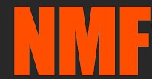
ANALYSIS PROCESS
ITERATIVE DATA CLEANING & PROCESSING
BOOK-CROSSING & GOOGLE BOOK API DATA
CLUSTERING
MODELLING
Notes:
HOW WILL WE ACCOMPLISH THIS?
DATABASE
CLEANING/PROESSING
MODELLING
TOP 10 FEATURES AND A MODEL

Slide 14
MODELING RESULTS
RMSE → measures accuracy of predicted ratings
SVD was the best performing algorithm for RMSE
SVD still can be off by ~0.7 rating points for predictions
0.7 ratings points can push a below average book into average or above average category
Example: Predicted Rating: 4.0 → Actual Rating: 3.3 – 4.7
Notes:
Remove the table
Plain text for RMSE explanation
No RMSE
Example for raatings

Slide 15


OVERVIEW
AVERAGE 4 BOOKS READ PER YEAR PER PERSON
Notes:
TALK ABOUT THE BUSINESS PROBLEM
VISION ZERO
WHY IS VISION ZERO IMPORTANT

Slide 16
MODELING RESULTS
MODELS | RMSE | MAE | MSE | FCP
SVD | 1.37 | 1.10 | 1.88 | 0.54
KNN BASELINE | 1.40 | 1.13 | 1.96 | 0.55
KNN WITH MEANS | 1.50 | 1.16 | 2.26 | 0.71
KNN WITH Z-SCORE | 1.51 | 1.16 | 2.27 | 0.71
NMF | 1.58 | 1.26 | 2.50 | 0.57
KNN BASIC | 1.62 | 1.27 | 2.62 | 0.59
RMSE → measures accuracy of predicted ratings
MAE → measures average magnitude of prediction errors
MSE → measures average squared difference b/w predicted and actual ratings
FCP → measures the system’s ranking accuracy
RMSE → used for selecting the final model
Ratings accuracy important for predicting unknow ratings
SVD was the best performing algorithm for RMSE, MAE and MSE
SVD used in conjunction with collaborative filtering
Notes:
RMSE is crucial for a book recommendation system as it measures the accuracy of predicted ratings, ensuring that users receive highly relevant and personalized book recommendations.
MAE (Mean Absolute Error) is relevant for a book recommendation system as it quantifies the average magnitude of the prediction errors, providing insight into the system's overall accuracy and the level of deviation from users' actual preferences.
MSE (Mean Squared Error) is relevant for a book recommendation system as it measures the average squared difference between predicted and actual ratings, allowing for a comprehensive evaluation of the system's predictive performance and highlighting the impact of large errors.
FCP (Fraction of Concordant Pairs) is relevant for a book recommendation system as it assesses the system's ability to correctly rank and compare book pairs based on user preferences, providing a measure of the system's ranking accuracy and user satisfaction.

Slide 17
MODELING RESULTS
RMSE → measures accuracy of predicted ratings
RMSE → used for selecting the final model
Ratings accuracy important for predicting unknow ratings
SVD was the best performing algorithm for RMSE, MAE and MSE
SVD used in conjunction with hybrid collaborative filtering
SVD still can be off by ~0.7 rating points for predictions
0.7 ratings points can push a below average book into average or above average category
MODELS | RMSE
SVD | 0.72
KNN BASELINE | 0.74
KNN WITH MEANS | 0.80
KNN WITH Z-SCORE | 0.81
NMF | 0.81
KNN BASIC | 0.84
Notes:
RMSE is crucial for a book recommendation system as it measures the accuracy of predicted ratings, ensuring that users receive highly relevant and personalized book recommendations.
MAE (Mean Absolute Error) is relevant for a book recommendation system as it quantifies the average magnitude of the prediction errors, providing insight into the system's overall accuracy and the level of deviation from users' actual preferences.
MSE (Mean Squared Error) is relevant for a book recommendation system as it measures the average squared difference between predicted and actual ratings, allowing for a comprehensive evaluation of the system's predictive performance and highlighting the impact of large errors.
FCP (Fraction of Concordant Pairs) is relevant for a book recommendation system as it assesses the system's ability to correctly rank and compare book pairs based on user preferences, providing a measure of the system's ranking accuracy and user satisfaction.

Slide 18
NEXT STEPS & IMPROVEMENTS
Higher Granularity and more features for user and product personas
Further modelling to bring accuracy close to 0.25 rating points
Improve Sampling Methods to increase amount and diversity of data
Incorporate Pipelines and User-Feedback loop Updates
Incorporate information on whether user has owned a book previously
Incorporate information on book-based movies / tv shows
Notes:
only keep the highlighted portions

